Slide 1
Unraveling Evolutionary Relationships: A Phylogenetic Exploration of parasite receptor in Anopheline Species"
Babatunde Oriyomi

Slide 2
Background
Pfs47 allows Plasmodium falciparum parasites to survive and be transmitted
By making them “undetectable” to the mosquito immune system.
P. falciparum parasites express Pfs47 haplotypes compatible with their mosquito vectors.
The receptor pfs47 binds to in vectors is also evolutionarily divergent
Notes:
Pfs47 protein found on the surface of

Slide 3
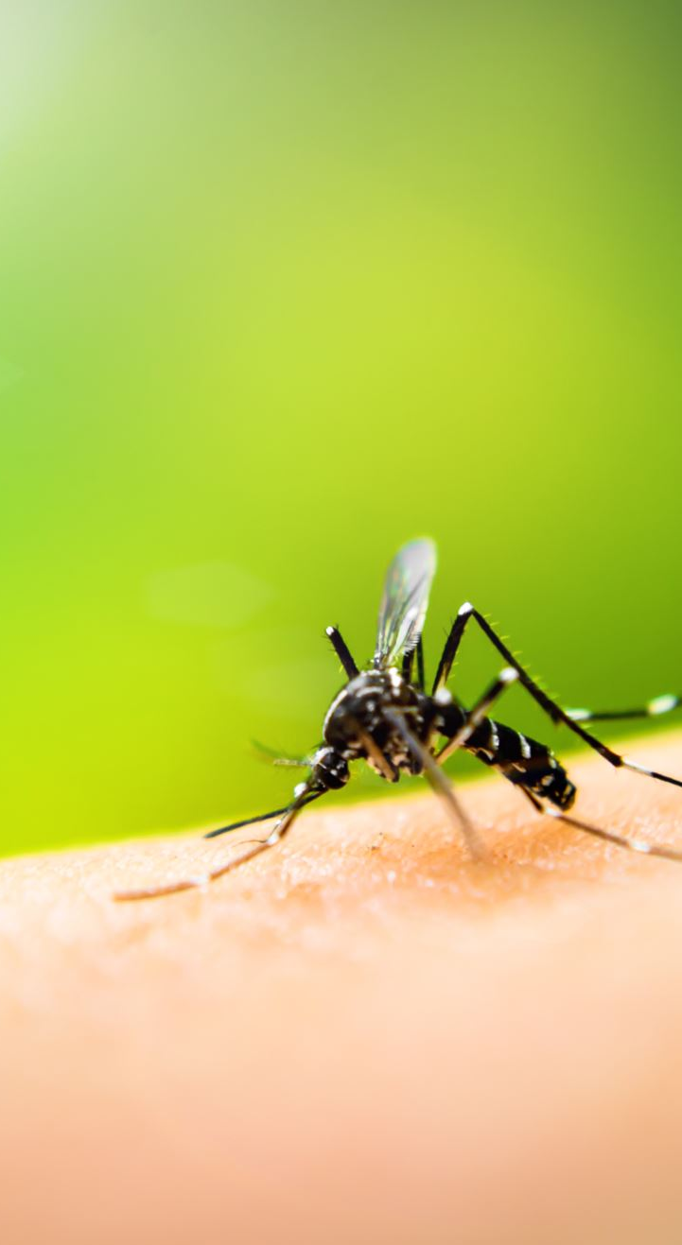
Research Questions
How closely related are the pfs47 receptor found in different Anopheles Mosquito species.
Can any relationship be observed between Pfs47 receptor of Anopheles species and other mosquito species

Slide 4
Packages used in R environment
Ape: facilitates phylogenetic tree construction through functions for inference, manipulation, visualization, and data handling.
Seqinr : Read, manipulate and analyze biological sequence
phangorn: Implements methods for phylogenetic reconstruction and analysis.
ggtree: ggtree is a powerful R package designed for the visualization and annotation of phylogenetic trees,
Tidyverse: for data manipulation, visualization and modelling

Slide 5

Steps in Tree construction
Read file into R
Run alignment
Construct Genetic distance with substitution model
Estimate Maximum likelihood (Bayesian inference )
Add Bootstrap values
Notes:
there are four nucleotides, there are 16 different possible substitution probabilities, including the probability that a nucleotide will remain the same over time
Likelihood provides us with a statistical framework to evaluate whether a model fits the data we observe
Maximum likelihood has a strong statistical foundation. Given a correct model of evolutionary change, it is guaranteed to be statistically consistent, i.e. it will converge on the correct tree as more data is added. Maximum likelihood generally performs the best of all methods in simulations
Bootstrap value is like a confidence score for branches in a family tree, showing how certain we are about the relationships between different species.

Slide 6
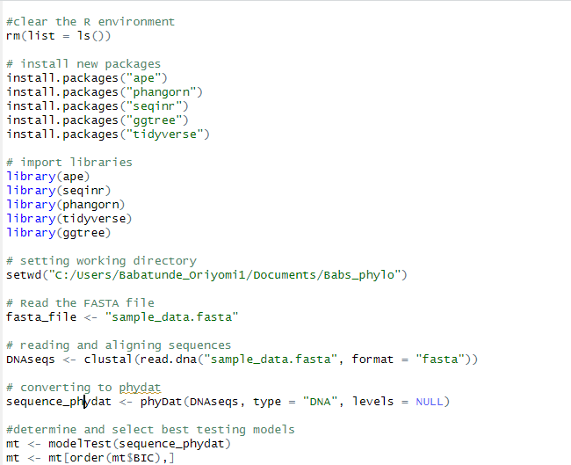
Install packages and Import fasta files

Slide 7
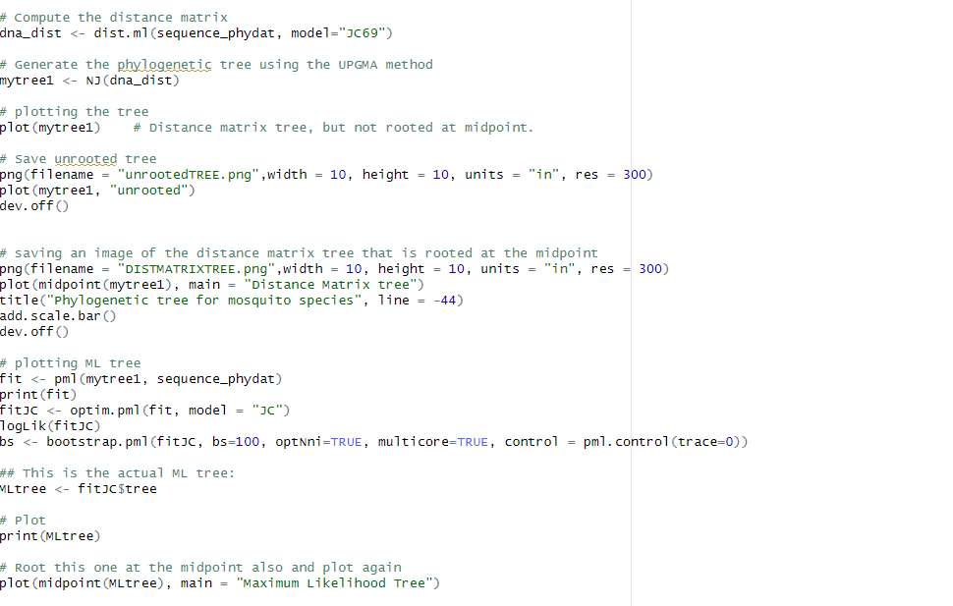

Slide 8
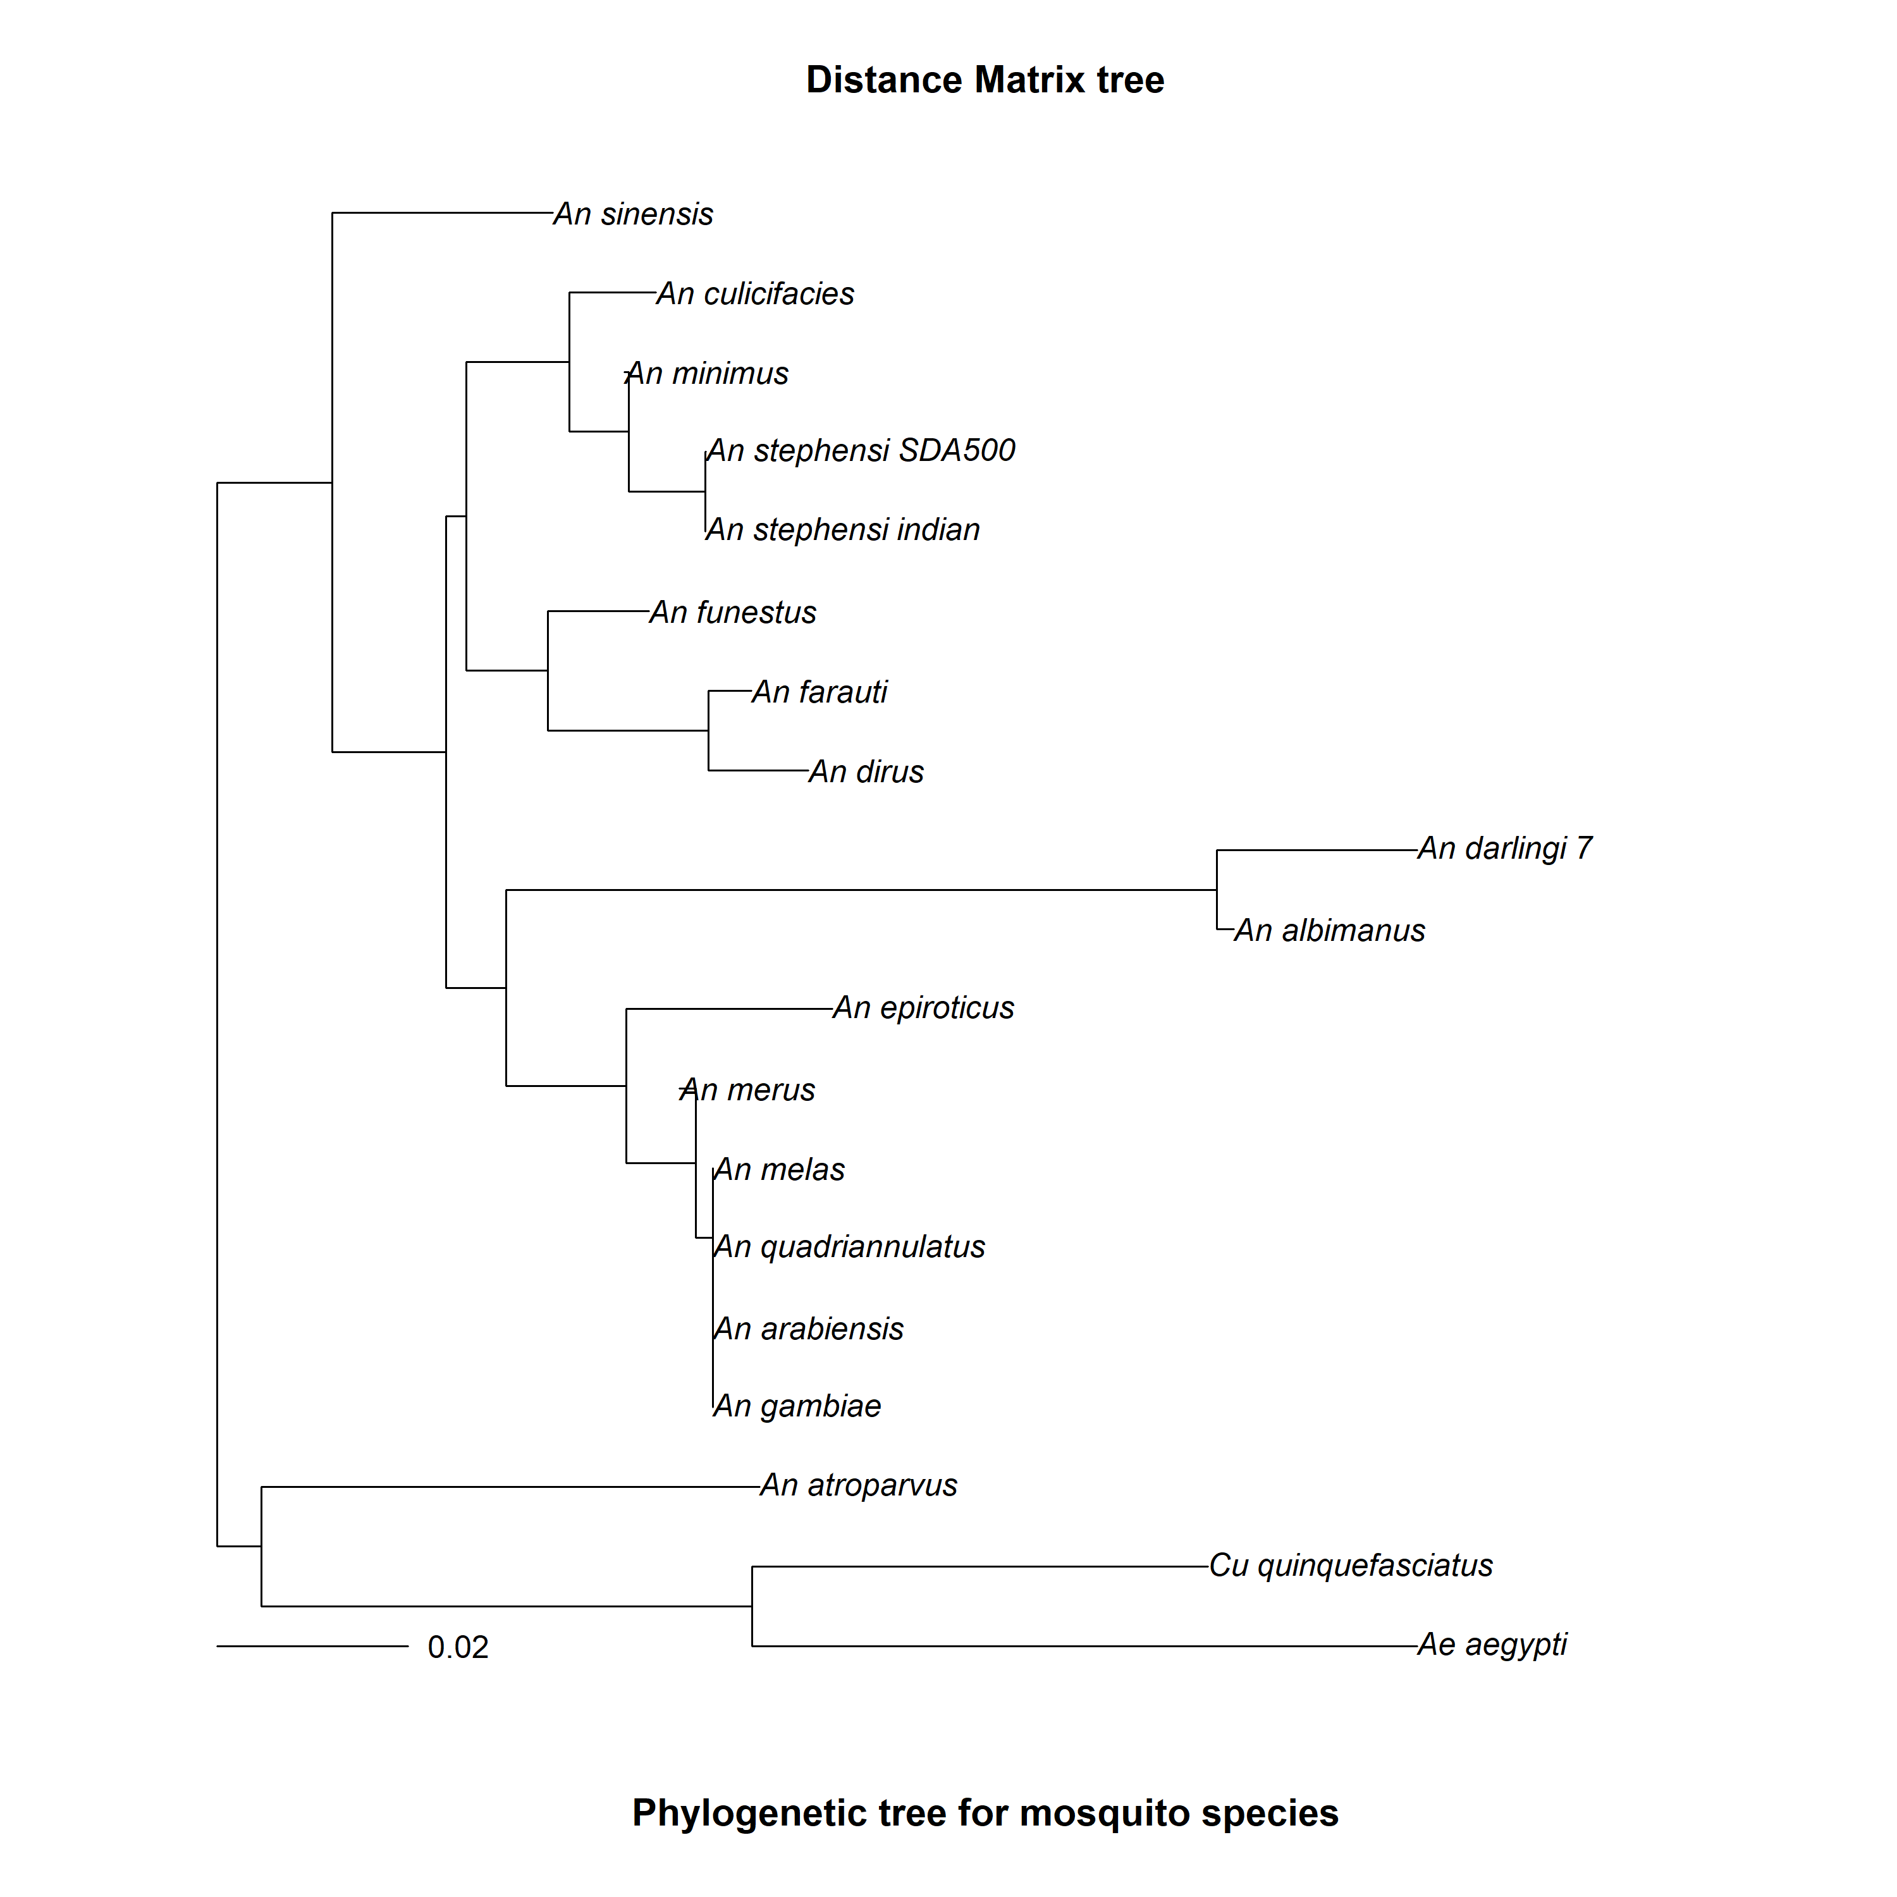
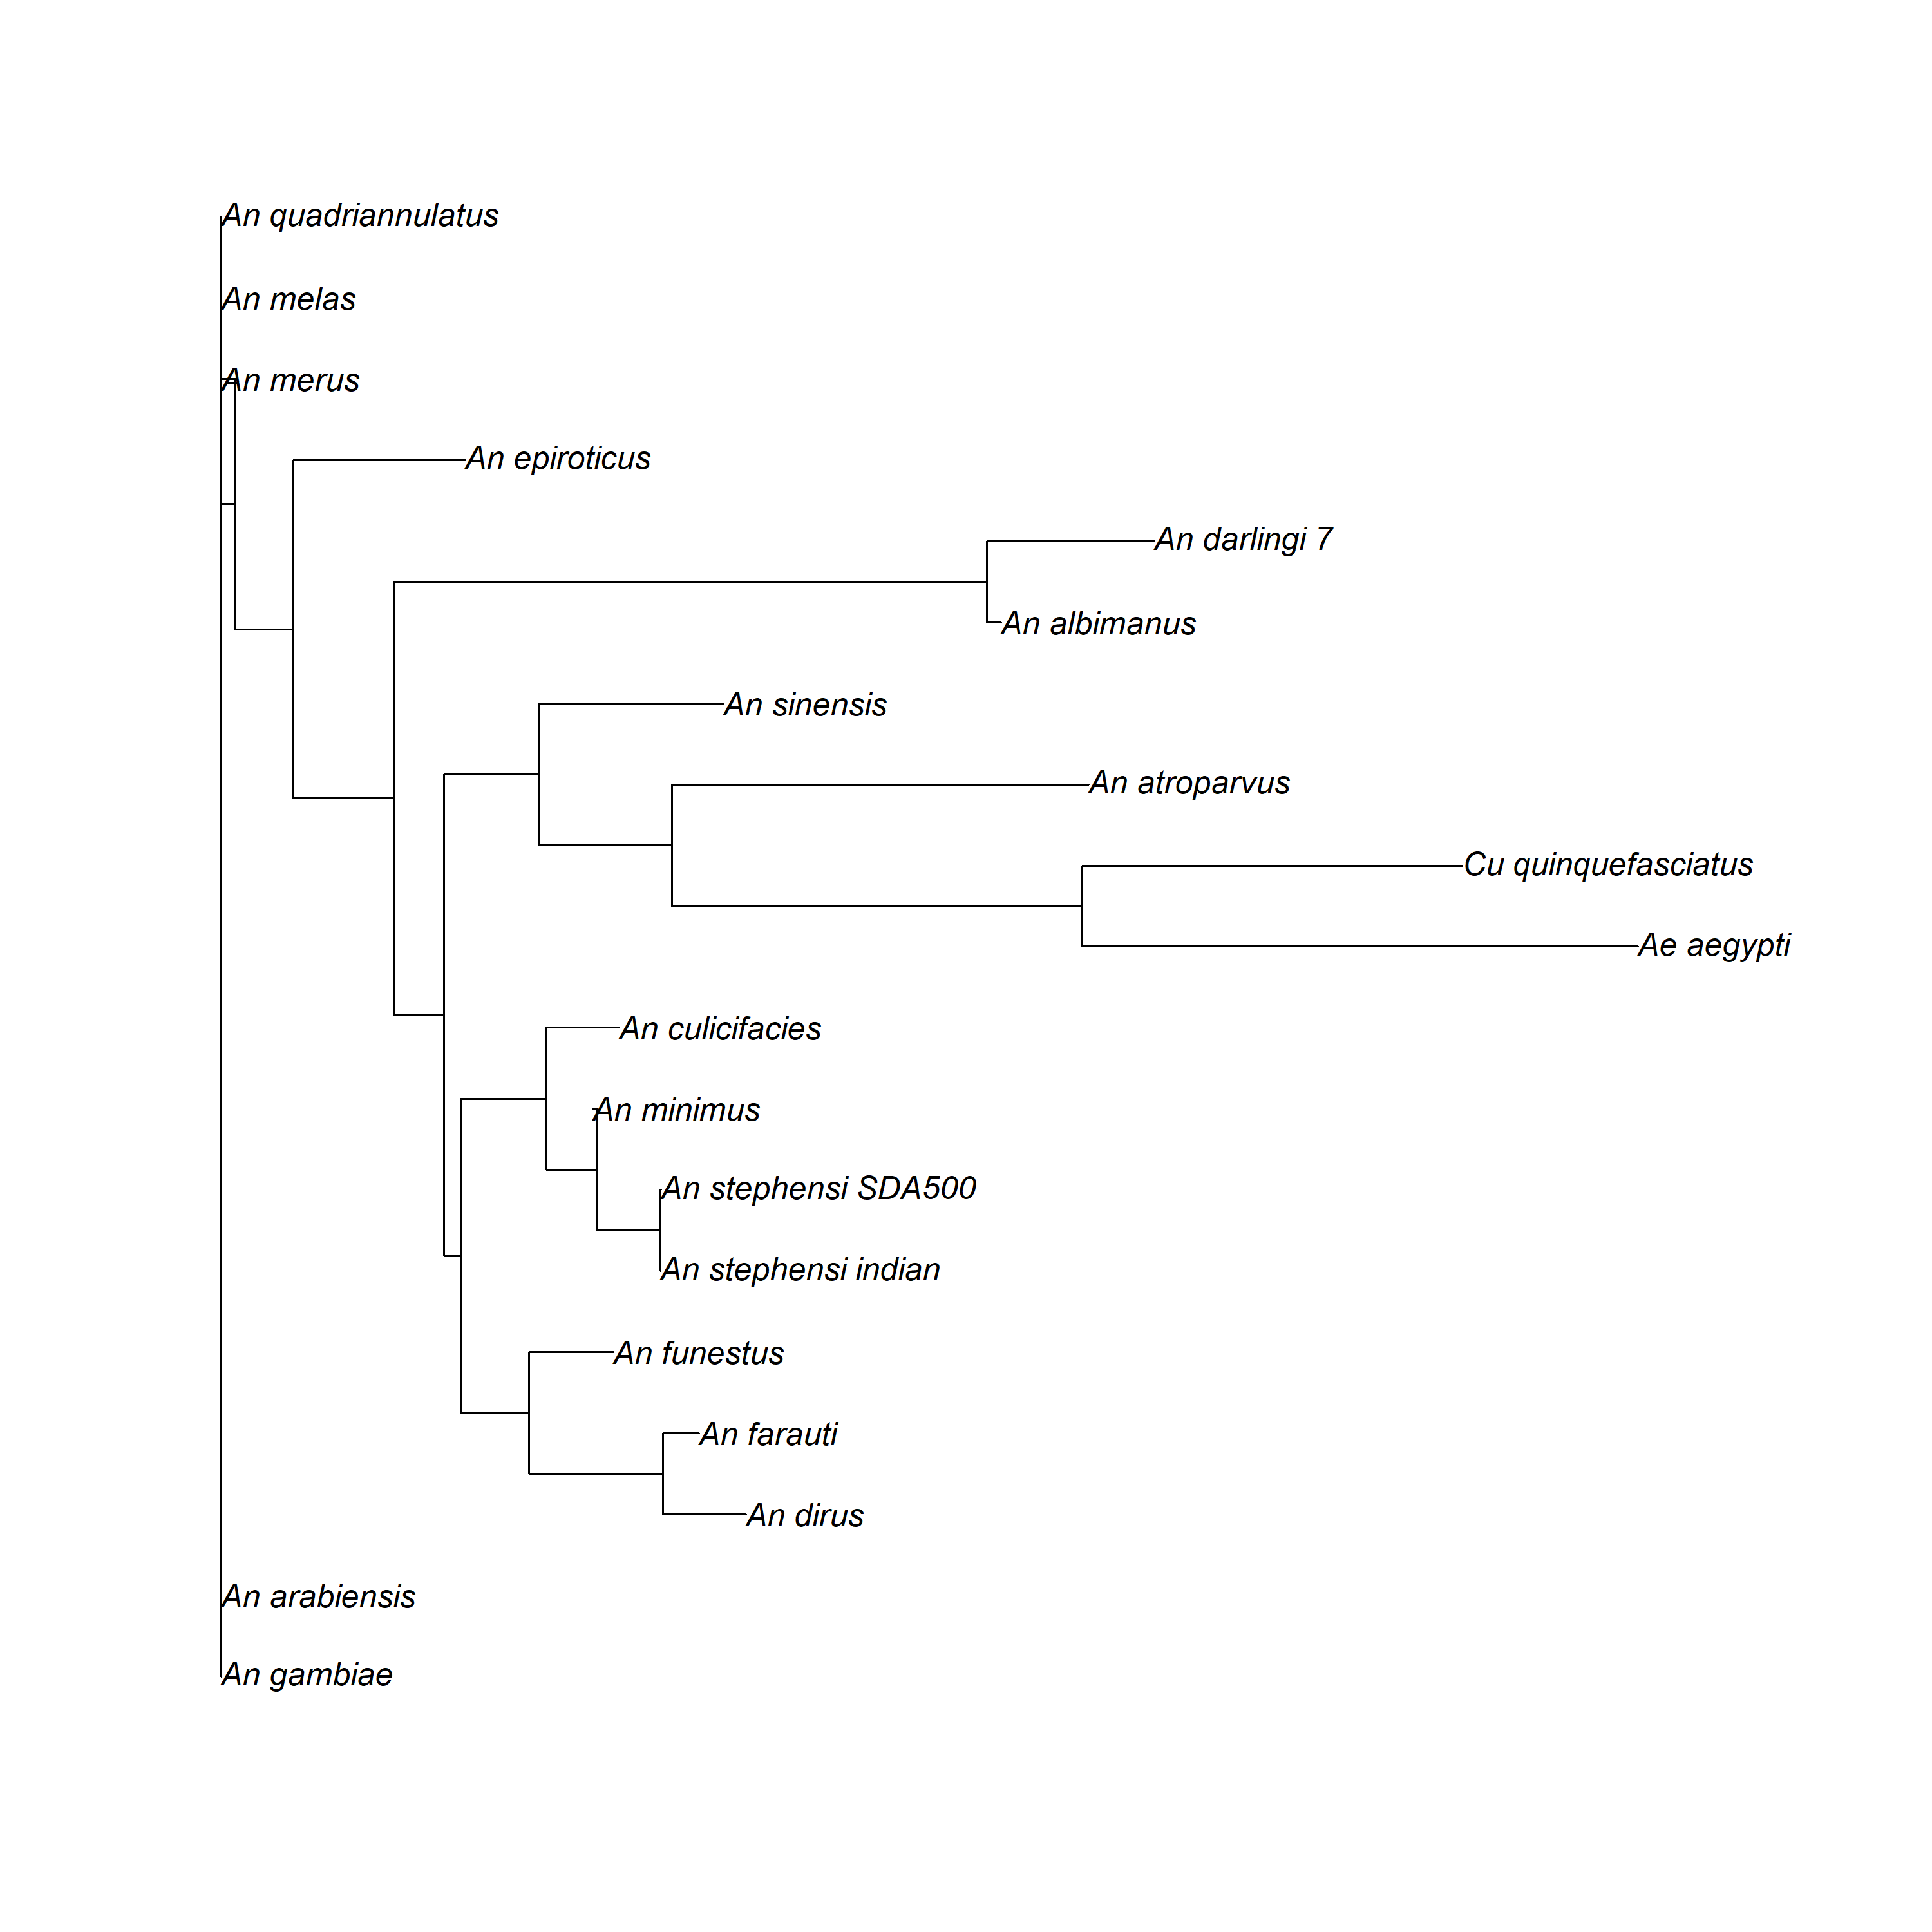
Distance Matrix Tree

Slide 9
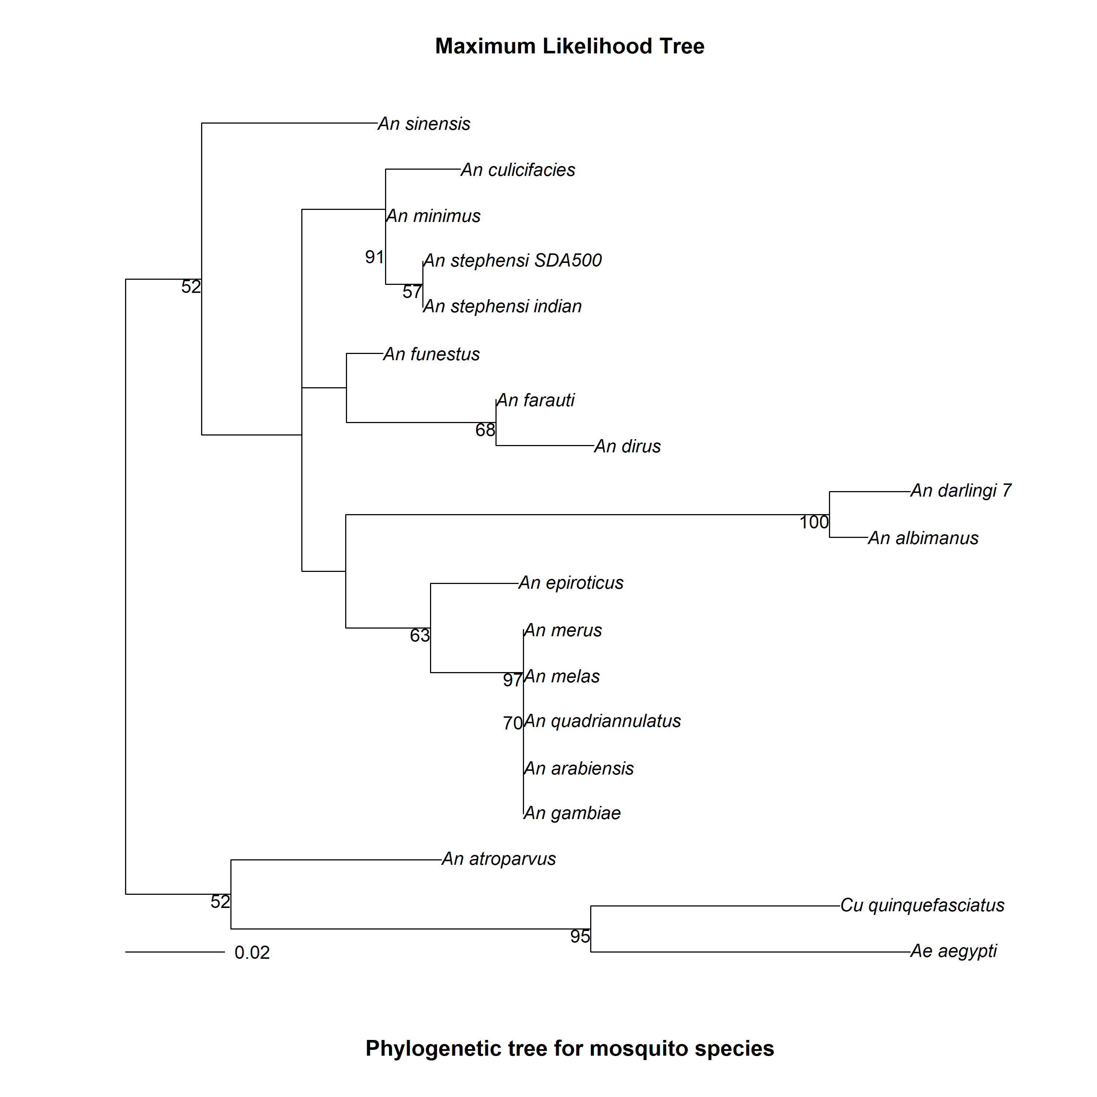
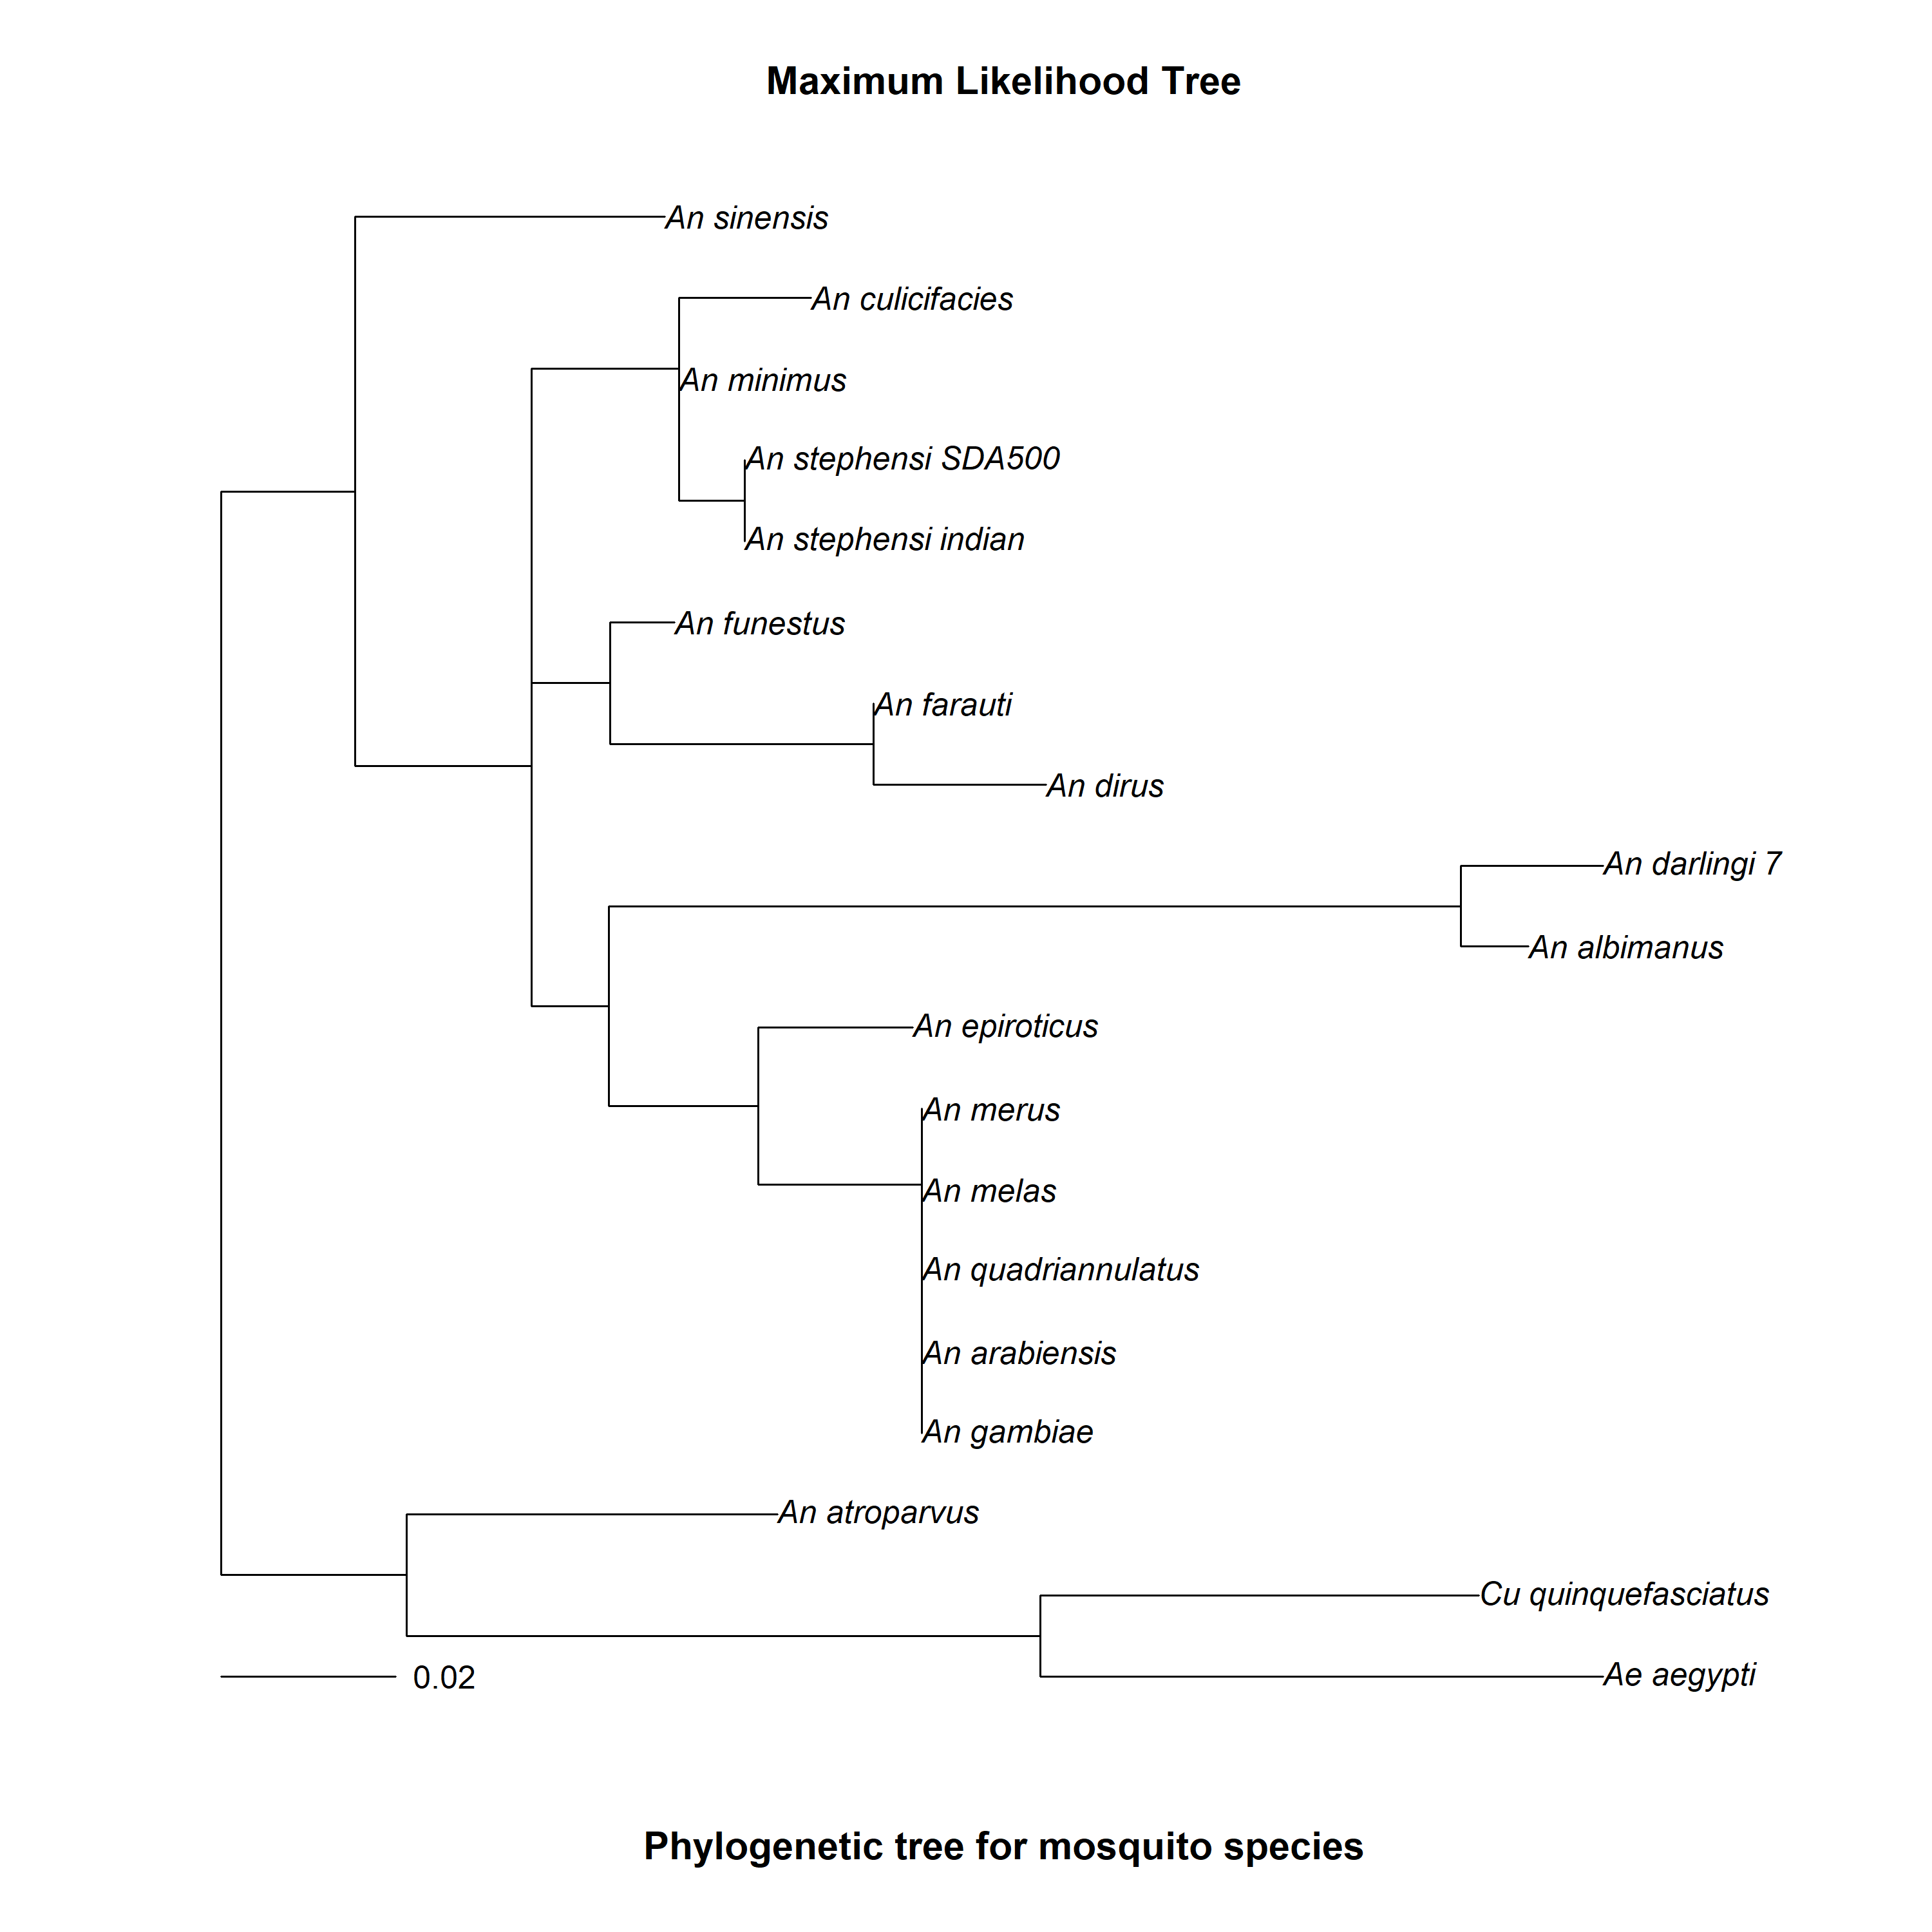

Slide 10
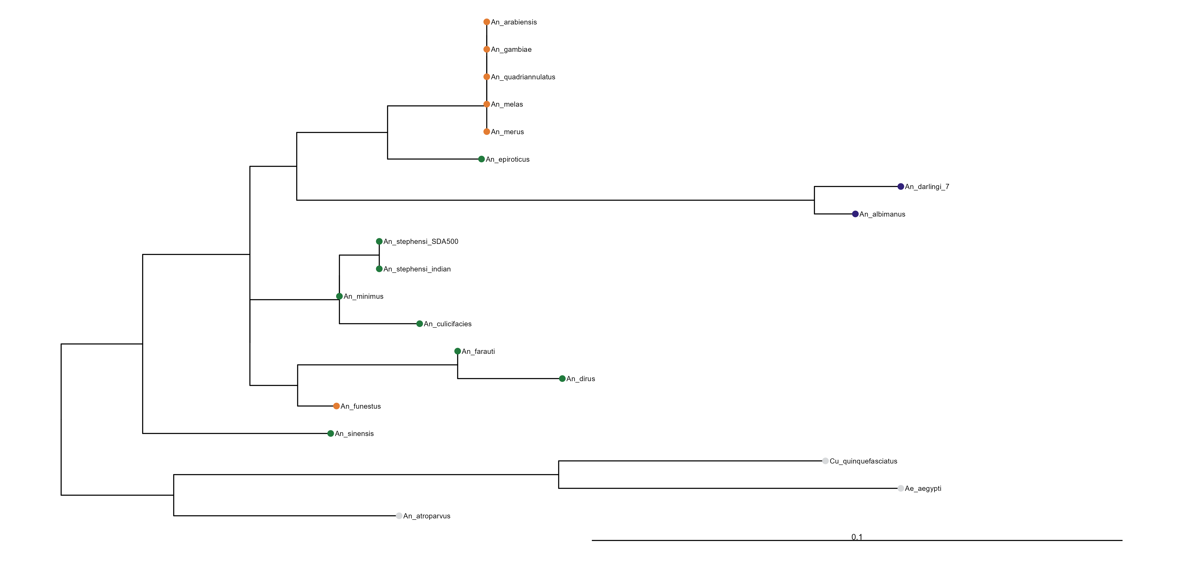
Notes:
which differs between malaria vector species from different continents, such as A. gambiae (Africa), Anopheles dirus (South East Asia), and A. albimanus (Central and South America) (21).

Slide 11
References
Molina-Cruz A, Canepa GE, Alves E Silva TL, Williams AE, Nagyal S, Yenkoidiok-Douti L, Nagata BM, Calvo E, Andersen J, Boulanger MJ, Barillas-Mury C. Plasmodium falciparum evades immunity of anopheline mosquitoes by interacting with a Pfs47 midgut receptor. Proc Natl Acad Sci U S A. 2020 Feb 4;117(5):2597-2605. doi: 10.1073/pnas.1917042117. Epub 2020 Jan 22. PMID: 31969456; PMCID: PMC7007573
Molina-Cruz A, Canepa GE, Kamath N, Pavlovic NV, Mu J, Ramphul UN, Ramirez JL, Barillas-Mury C. Plasmodium evasion of mosquito immunity and global malaria transmission: The lock-and-key theory. Proc Natl Acad Sci U S A. 2015 Dec 8;112(49):15178-83. doi: 10.1073/pnas.1520426112. Epub 2015 Nov 23. PMID: 26598665; PMCID: PMC4679011.
Manske M, Miotto O, Campino S, Auburn S, Almagro-Garcia J, Maslen G, O'Brien J, Djimde A, Doumbo O, Zongo I, Ouedraogo JB, Michon P, Mueller I, Siba P, Nzila A, Borrmann S, Kiara SM, Marsh K, Jiang H, Su XZ, Amaratunga C, Fairhurst R, Socheat D, Nosten F, Imwong M, White NJ, Sanders M, Anastasi E, Alcock D, Drury E, Oyola S, Quail MA, Turner DJ, Ruano-Rubio V, Jyothi D, Amenga-Etego L, Hubbart C, Jeffreys A, Rowlands K, Sutherland C, Roper C, Mangano V, Modiano D, Tan JC, Ferdig MT, Amambua-Ngwa A, Conway DJ, Takala-Harrison S, Plowe CV, Rayner JC, Rockett KA, Clark TG, Newbold CI, Berriman M, MacInnis B, Kwiatkowski DP. Analysis of Plasmodium falciparum diversity in natural infections by deep sequencing. Nature. 2012 Jul 19;487(7407):375-9. doi: 10.1038/nature11174. PMID: 22722859; PMCID: PMC3738909.
Makanga B, Yangari P, Rahola N, Rougeron V, Elguero E, Boundenga L, Moukodoum ND, Okouga AP, Arnathau C, Durand P, Willaume E, Ayala D, Fontenille D, Ayala FJ, Renaud F, Ollomo B, Prugnolle F, Paupy C. Ape malaria transmission and potential for ape-to-human transfers in Africa. Proc Natl Acad Sci U S A. 2016 May 10;113(19):5329-34. doi: 10.1073/pnas.1603008113. Epub 2016 Apr 11. PMID: 27071123; PMCID: PMC4868493.32. R. E. Harbach, “The phylogeny and classification of Anopheles” Anopheles Mosquitoes–New Insights into Malaria Vectors, Manguin S. (InTech, London, UK, 2013).
Padrón A, Molina-Cruz A, Quinones M, Ribeiro JM, Ramphul U, Rodrigues J, Shen K, Haile A, Ramirez JL, Barillas-Mury C. In depth annotation of the Anopheles gambiae mosquito midgut transcriptome. BMC Genomics. 2014 Jul 29;15(1):636. doi: 10.1186/1471-2164-15-636. PMID: 25073905; PMCID: PMC4131051.

